Slide 1
Experiment Number
To find out the energy band gap of a semiconductor by four probe method.
Learning Objectives
To measure the resistivity of a semiconductor material using four probe method.
2. To study the temperature variation of resistivity of a semiconductor material.
3. To find out the energy band gap of a semiconductor.

Slide 2
The student will also be able
To visualize the position of the four probes on the sample in the virtual lab environment.
To select the range and values of different variables to conduct the experiment.
To find out the values of the voltage across the sample, while passing a fixed amount of current, at different measuring temperature.
To calculate resistivity of the sample under consideration from the simulator data.
5. To understand the temperature variation of resistivity of a semiconductor sample by plotting suitable graph.

Slide 3
Basic Understandings

Slide 4

Semiconductor
Semiconductors are materials which have electrical conductivities lying between good conductors and insulators.
Elemental semiconductors such as silicon germanium belongs to the Group IV of the periodic table.
Natural pure form of a semiconductor is known as intrinsic semiconductor.
Conductivity is mainly to due thermally generated charge carriers.
Electron hole pair generation on breaking of a covalent bond.
Conduction band
Energy
Energy band gap
Valence band
Electronic configuration of Ge: 1s²2s²2p⁶3s²3p⁶3d¹⁰4s²4p²
Electronic configuration of Si : 1s²2s²2p⁶3s²3p²
Semiconductor wafer
Dr. Subhojyoti Sinha

Slide 5
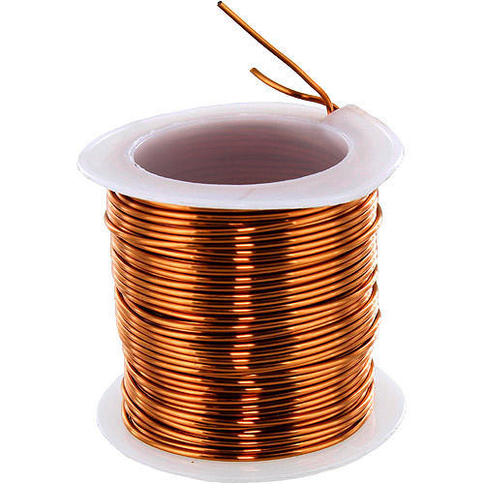

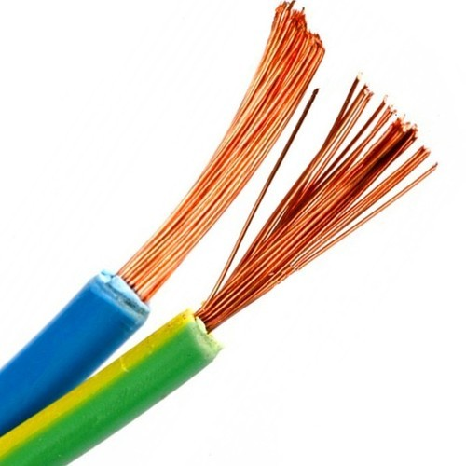
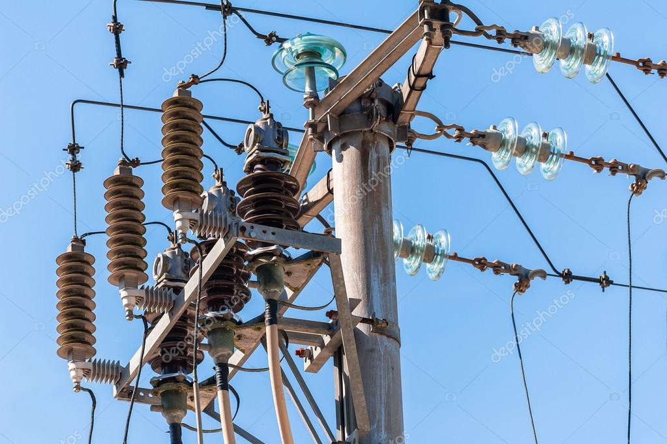
Metals , Semiconductors, Insulators
Germanium or Silicon (semiconductor)
Wood (insulator)
Copper
( metal)
Resistivity ranges ( approx.)
Conductors: 10⁻⁸ to 10⁻⁶ ohm-m semiconductors: 10⁻⁵ to 10⁴ ohm-m
Insulator: 10⁷ to 10⁸ ohm -m
Ceramic insulator
Plastic (insulator)
Dr. Subhojyoti Sinha

Slide 6
Energy band gap
The energy difference between the valence band and conduction band is called band gap.
In case of semiconductors the energy gap between filled valence band and empty conduction band is small compared to insulators but more as compared to conductors.
The band gap of semiconductor varies from 0.2 to 2.5 eV. For Germanium it is ~0.67 eV. whereas the bandgap of a typical insulator (diamond) 6 eV.
Energy
Conduction band
free electrons
Energy band gap
holes
Valence band
Due to small energy band gap between the valence band and conduction band ,the electrons of valence band can be thermally excited to the conduction band.
Dr. Subhojyoti Sinha

Slide 7
Metal, Semiconductor and Insulator
Conduction band
Conduction band
Energy band gap
Overlapping of Conduction and Valence band
Energy
Energy
Energy
Energy band gap
Valence band
Valence band
Metal
Semiconductor
Insulator
*Energy not to scale
Dr. Subhojyoti Sinha

Slide 8
Calculation of energy band gap of a semiconductor from the temperature variation of resistivity
The resistivity (ρ) of a semiconductor sample can be expressed as -
Where Eg is Band Gap in eV, k is Boltzmann constant =8.617×10⁻⁵ eVK⁻¹ , T is absolute temperature in Kelvin
The constant A depends on carrier concentrations and mobility of the charge carriers ( electrons and holes)
Taking natural logarithm on both side of equation (i)
Y - axis
( B is another Constant)
X -axis
Or
So by plotting a graph between log ρ versus 1000/T we can find out the slope and hence the energy band gap of the semiconductor material.
Dr. Subhojyoti Sinha

Slide 9

Check your understanding
Q
Q1.1 : Which of the following statement(s) is (are) true about semiconductors:
there is a small energy gap between the valence band and conduction band
valence band and conduction band overlap with each other.
electrons of valence band can be thermally excited to the conduction band.
both the options (A) and (C)

Slide 10
Check your understanding
Q
Q1.2 : The display panel of a temperature sensor indicates 45 °C. The corresponding temperature in Kelvin is
228 K
(B) 273 K
(C) 308 K
(D) 318 K

Slide 11
Check your understanding
Q
Where A is a constant, Eg is Band Gap in eV, k is the Boltzmann constant =8.617×10⁻⁵ eVK⁻¹ , T is absolute temperature in Kelvin

Slide 12
Check your understanding
Q
Q1.4 : With increase in temperature, the conductivity (σ=1/ρ) of the semiconductor sample
(A) decreases
(B) increases
(C) remains constant (D) suddenly drops to zero

Slide 13
Check your understanding
Q
Q1.5 : Unit of energy band gap is
Electron volt
Coulomb
(C) Volt/meter
(D) Joule/second

Slide 14
Step by Step guide to perform the experiment in Virtual lab
Dr. Subhojyoti Sinha

Slide 15
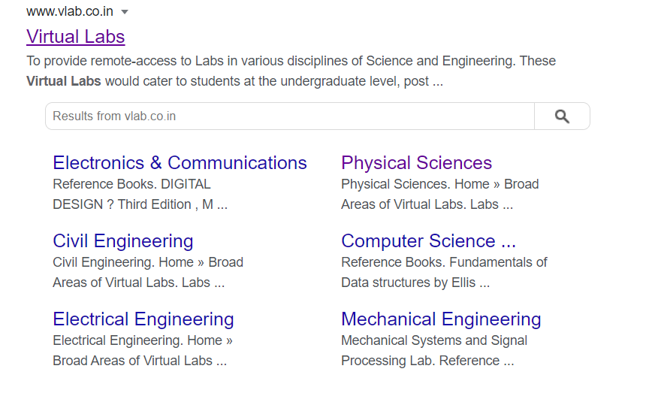

Type this link on the address bar or Click on this link : https://www.vlab.co.in/

Slide 16
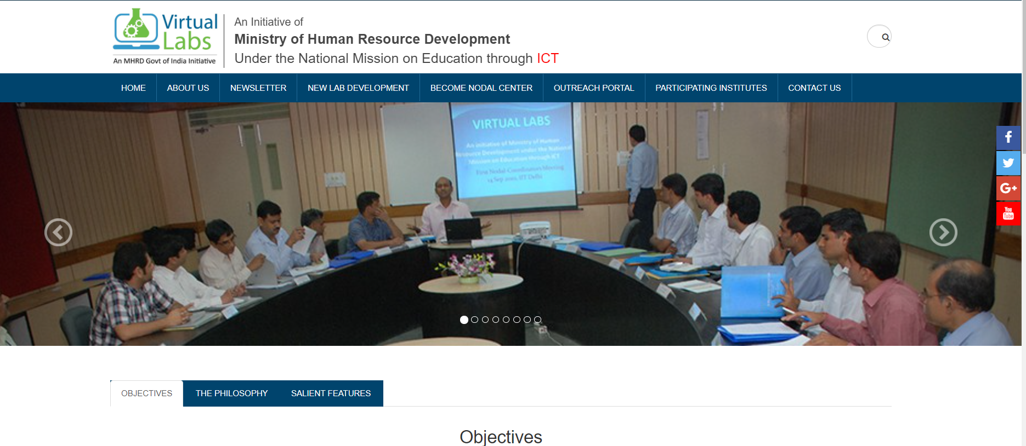
This page will open. Scroll down the page end click on Physical sciences

Slide 17
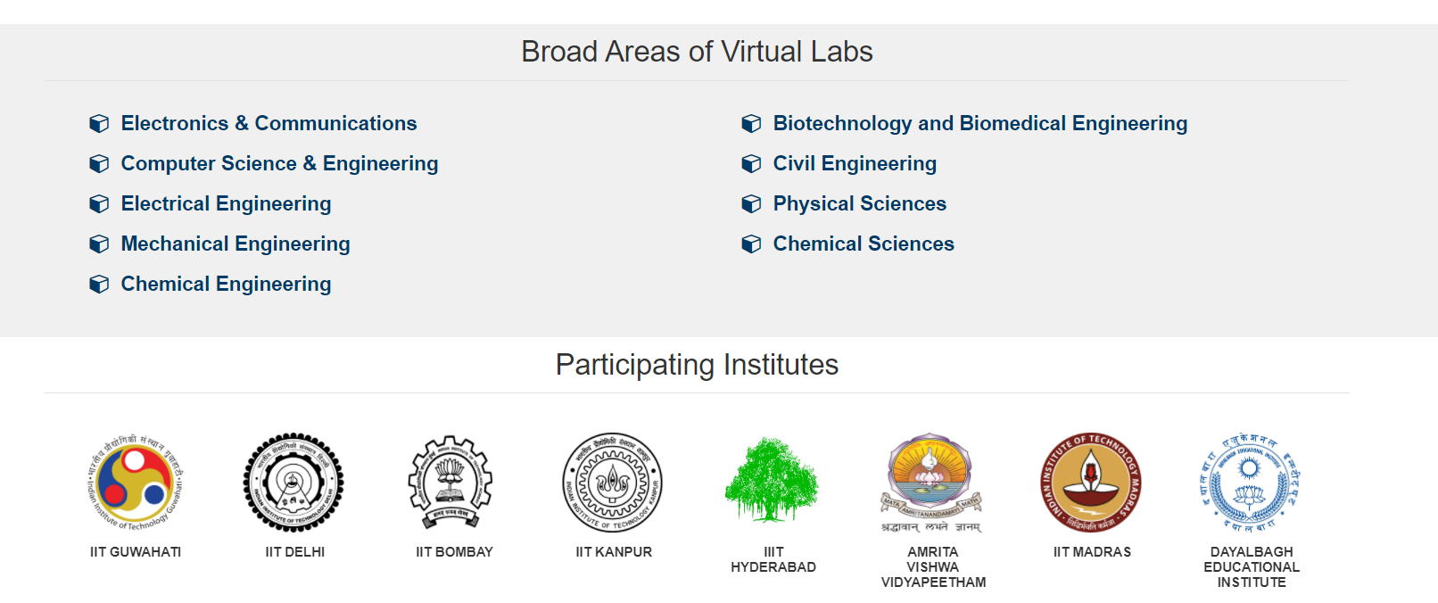
Scroll down the page end click on Physical sciences

Slide 18
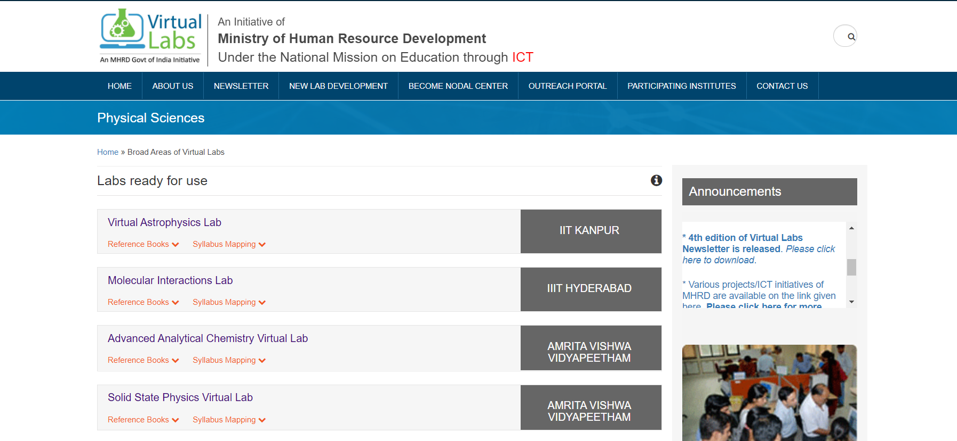
Then click on - Solid state Physics Virtual Lab

Slide 19
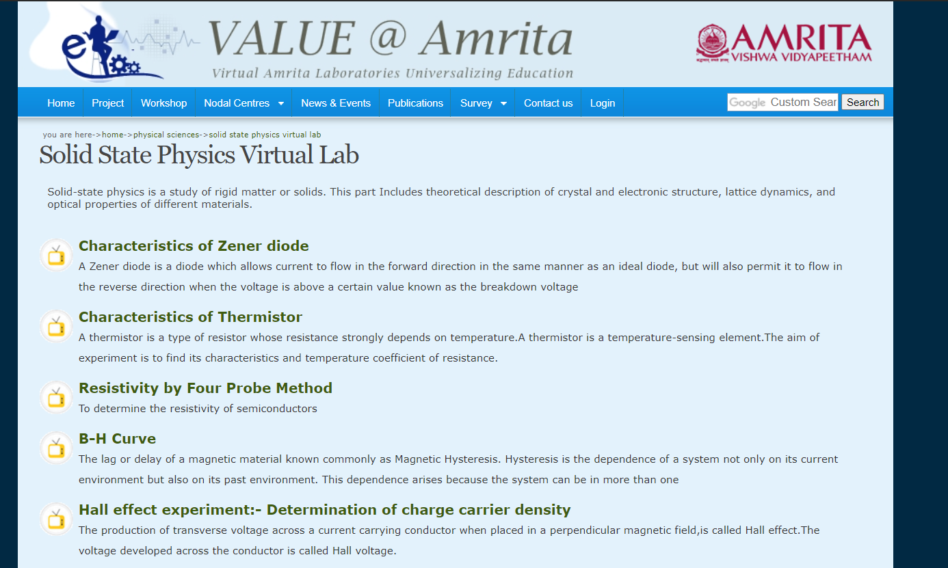
Then click on – Resistivity by Four probe Method

Slide 20
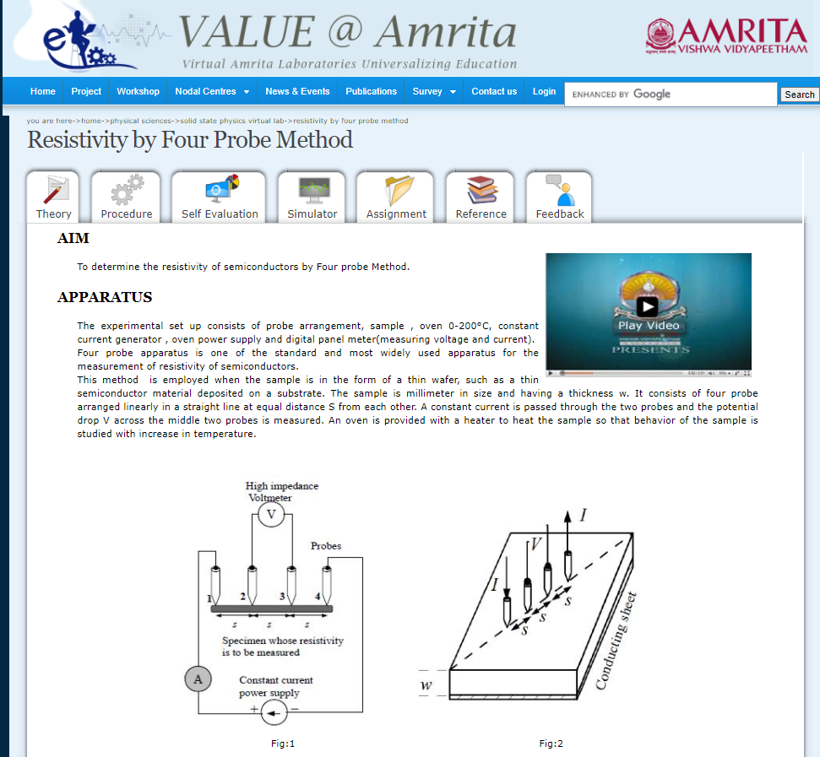
Details of the experiment will be available to you . You may login also.
Read the theory
Procedure
Complete the self evaluation to check your understanding
Then click on the simulator

Slide 21
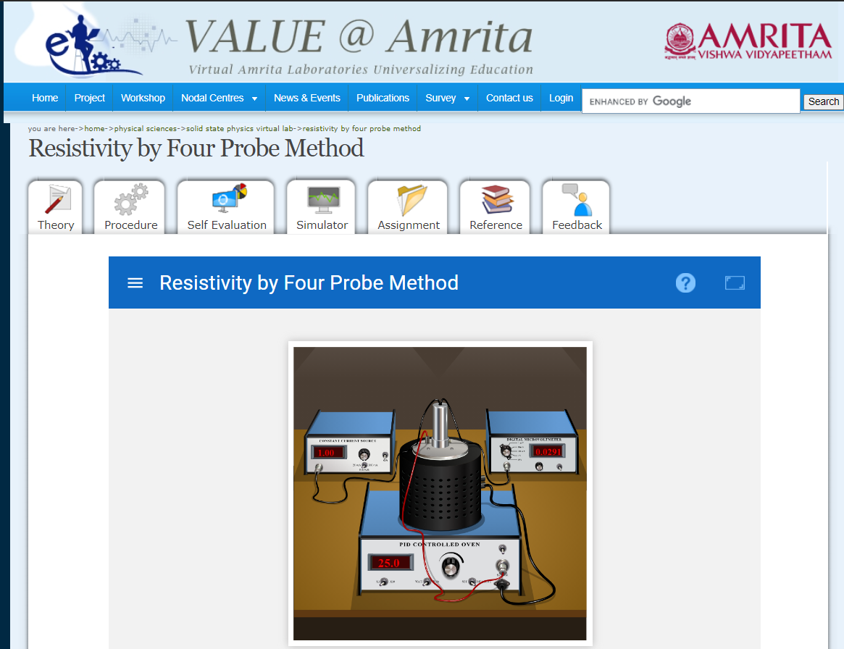
When Click on the simulator , this page will be visible
Then click here to open the list of variables

Slide 22
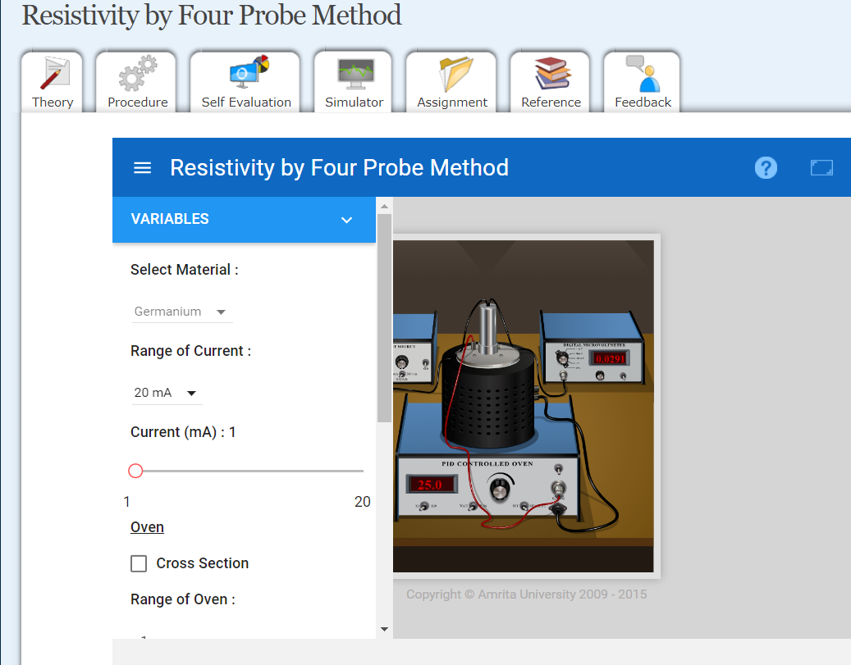
the list of variables is available now.
But it covers some portion of the oven and you have to toggle the show variables option while performing the experiment.

Slide 23
Click here to zoom

Slide 24
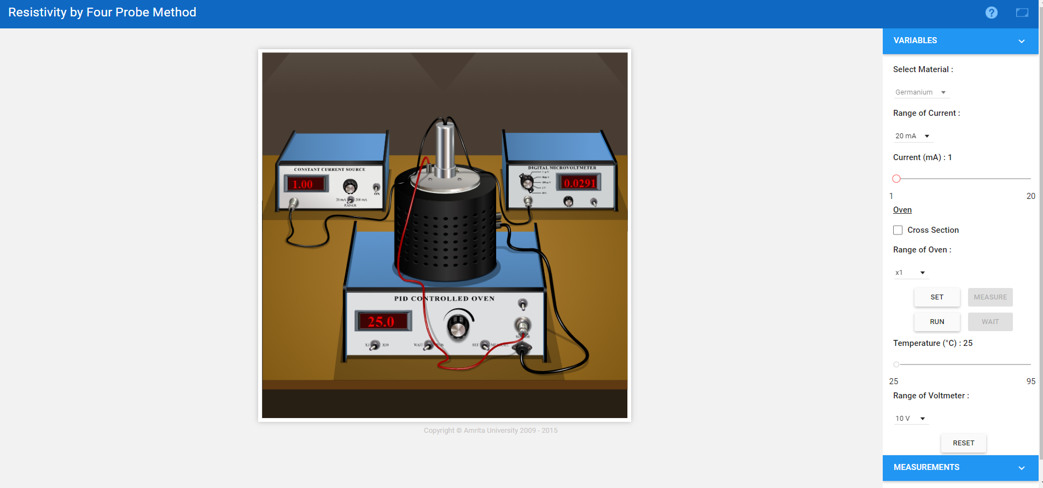
When Click on the simulator , this page will open
the list of variables is available now conveniently

Slide 25
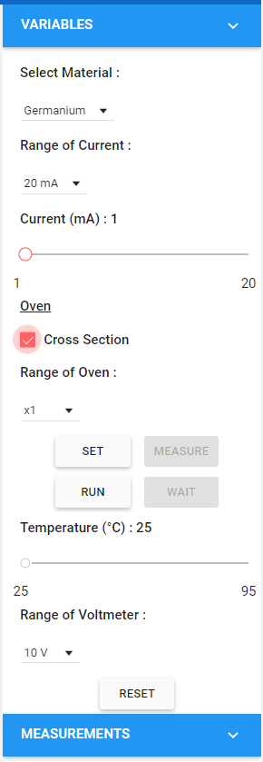
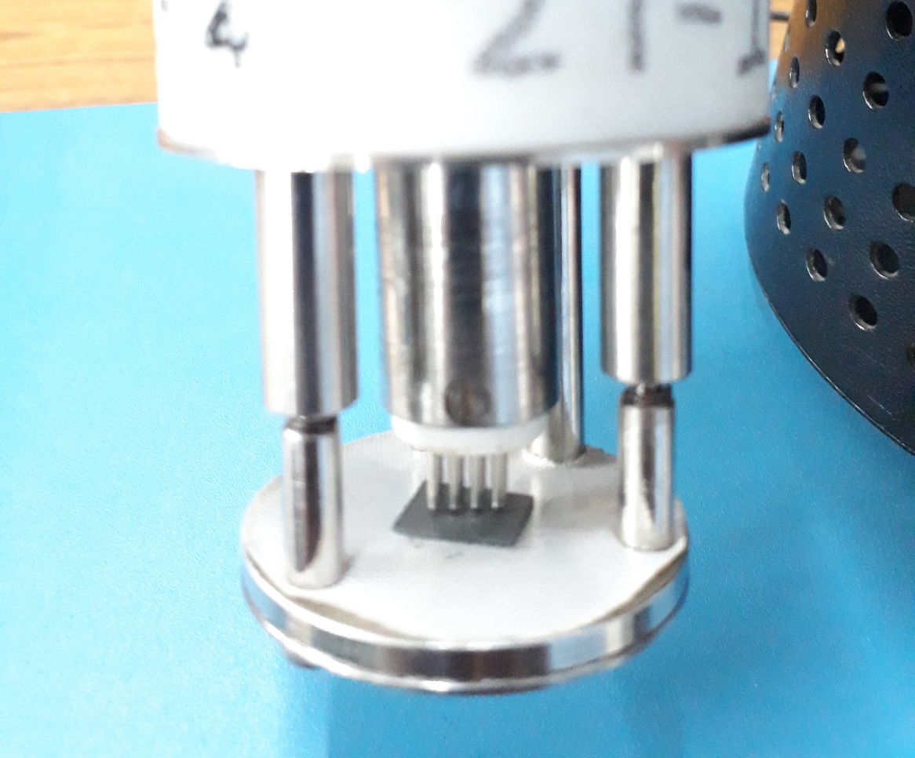
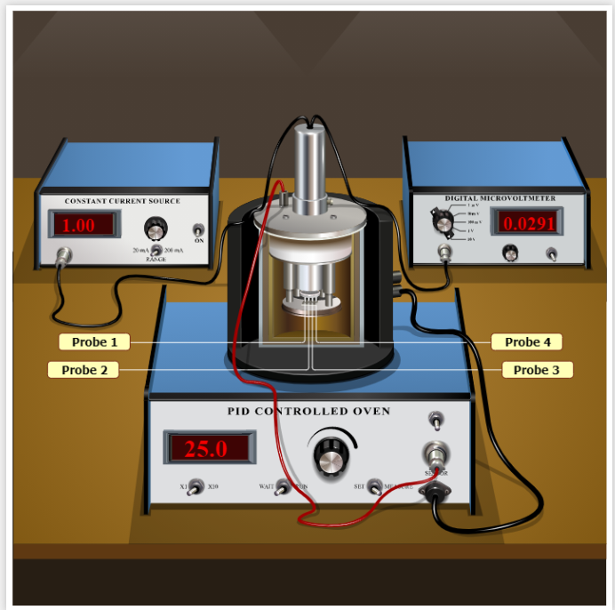
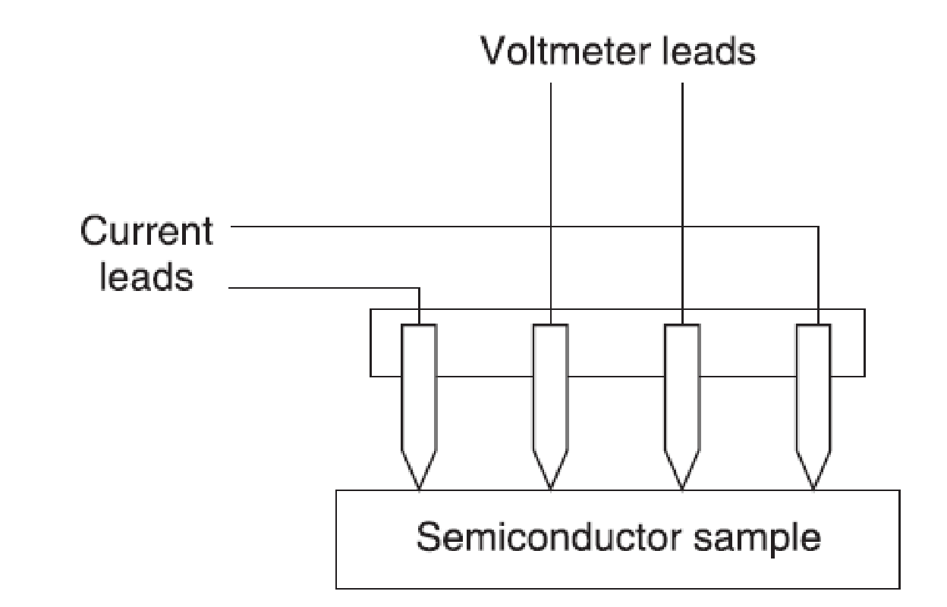
Click on the cross section checkbox to see the probes
Ge crystal
Four probes
s
w

Slide 26
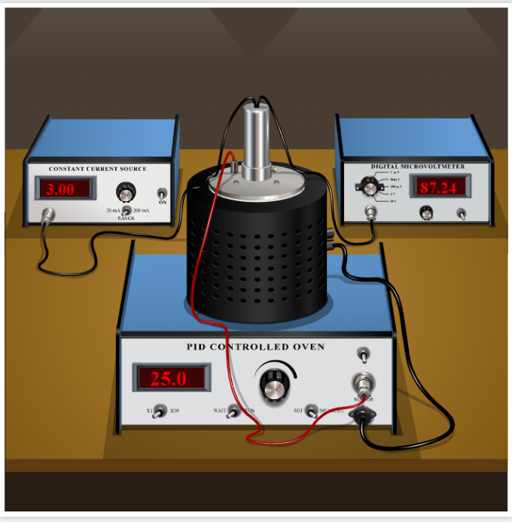
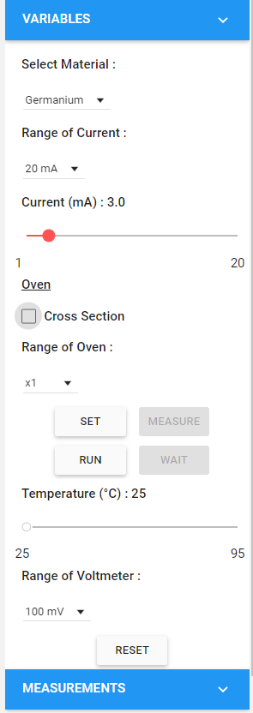
Selection of the variables
Select the material from the drop down button. Either Silicon or Germanium. Select Germanium here. Then Select the range of current to 20 mA
Set the current to say 3 mA
Set the range of the oven to x1
or 10 ( as required)
Set the range of the voltmeter to 100 mV from the drop down options
If you want to change the input values, only then click ‘Reset’ otherwise you are good to start the experiment.
Dr. Subhojyoti Sinha

Slide 27
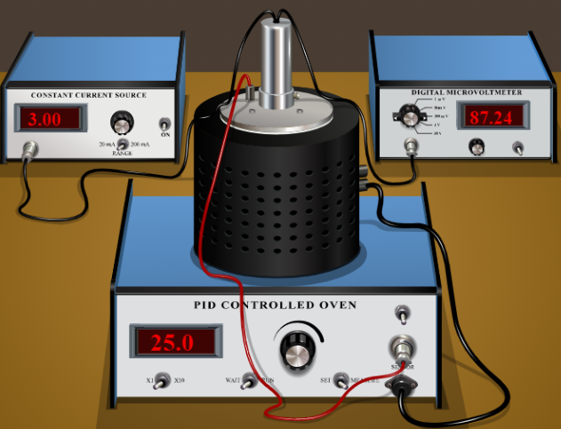
Next you have to set the temperature of the oven and run it.
Note: Convert the temperature from degree centigrade to Kelvin. Say if we want to perform the experiment from 25 °C to 70 °C. with step of 5 °C . Then write the temperature values in the worksheet column accordingly in Kelvin ( adding 273 to °C).

Slide 28

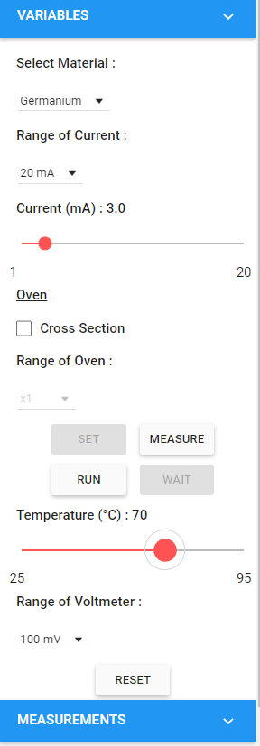
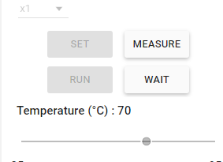
Then Click on “Set” and set the temperature ( say to 70 °C) by sliding the temperature bar.
Then Click on “Run”
Oven temperature will now increase. Check the oven display panel and click ‘’wait’ to note down the millivoltmeter readings (in the worksheet) at each 5°C ( or 5K) interval up to 70 °C (i.e. 343 K)
Now first note down the millivoltmeter reading at room temperature ( 25 °C ) in the worksheet. Then for other temperature values. Don’t forget to run again after noting down the readings.

Slide 29
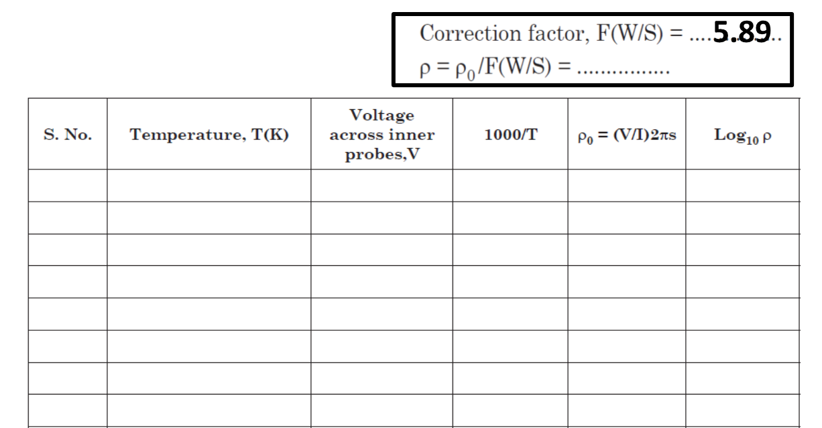
Worksheet
Current I= ……mA
Temperature ( °C) | Temperature ( K) | Voltage across inner probe (mV) | 1000/T |  | Considering the correction factor (ρ) unit | logρ
N.B: Take care about the unit.

Slide 30
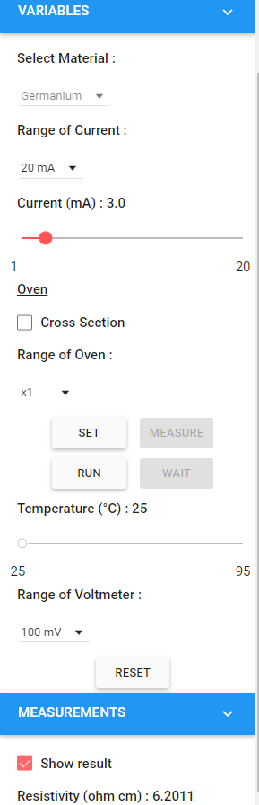
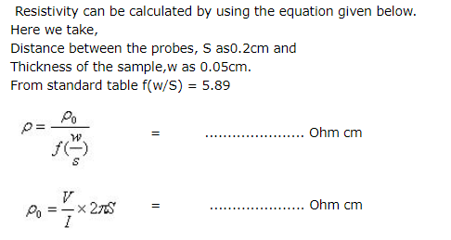
Temperature ( °C) | Temperature ( K) | Voltage across inner probe (mV) | 1000/T |  | Considering the correction factor (ρ) | logρ
Note by clicking this check box the student can find the resistivity value at any particular temperature. This is after considering the correction factor.

Slide 31
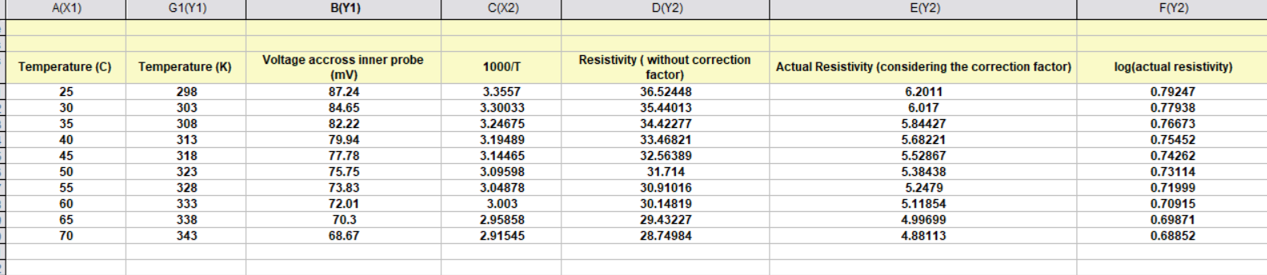
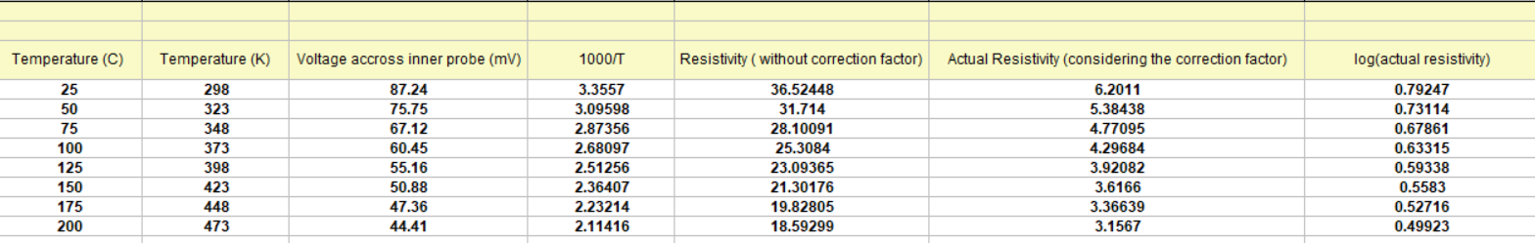
Sample Data taken from the virtual lab
Table 1 ( temperature range 25 to 70 C)
Current I set at 3 mA
Not to be shared with students
Table 1 ( temperature range 25 to 200 C) oven range set as x10
Table 2

Slide 32
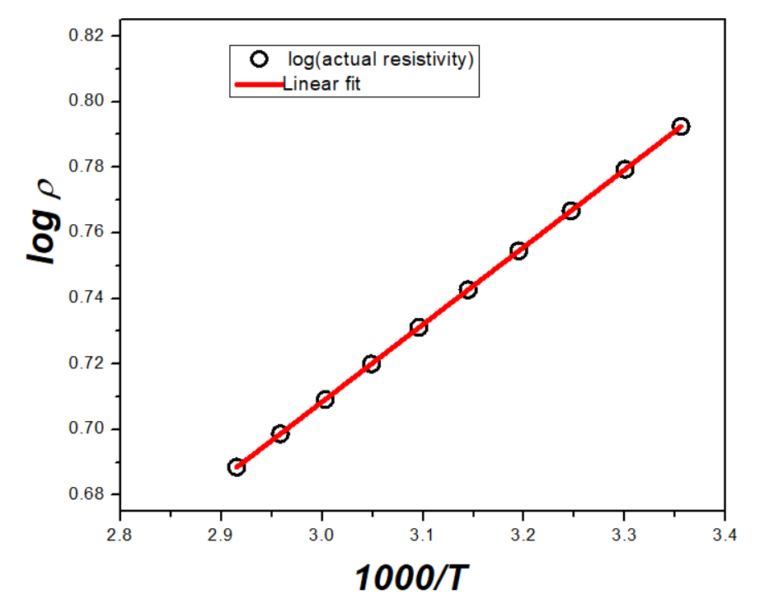
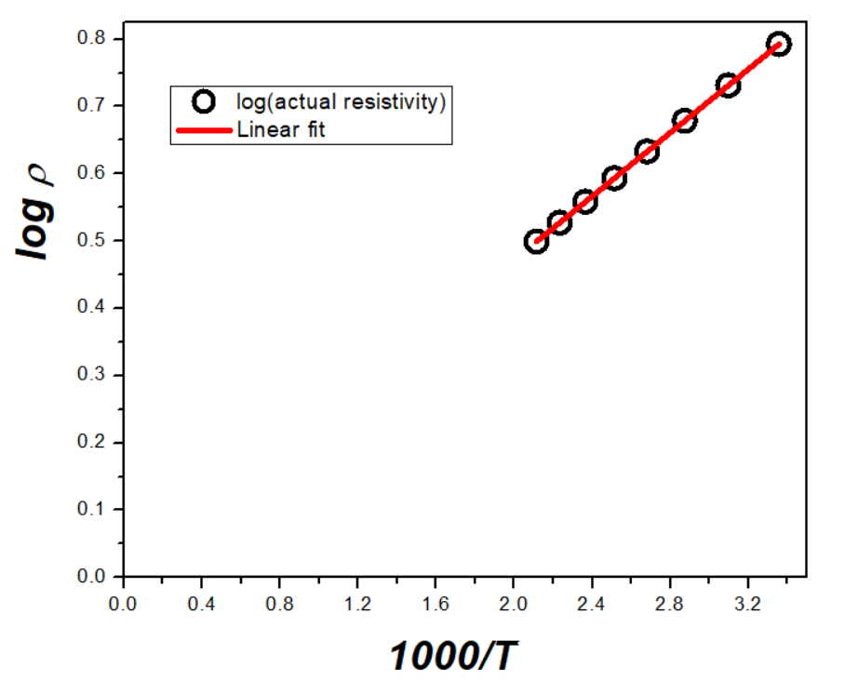
Plot the graph between 1000/T and log ρ.
*The students can plot the graph in normal graph paper (or in MS-Excel or any graph plotting software)
From table 1 ( zoomed )
From table 2

Slide 33
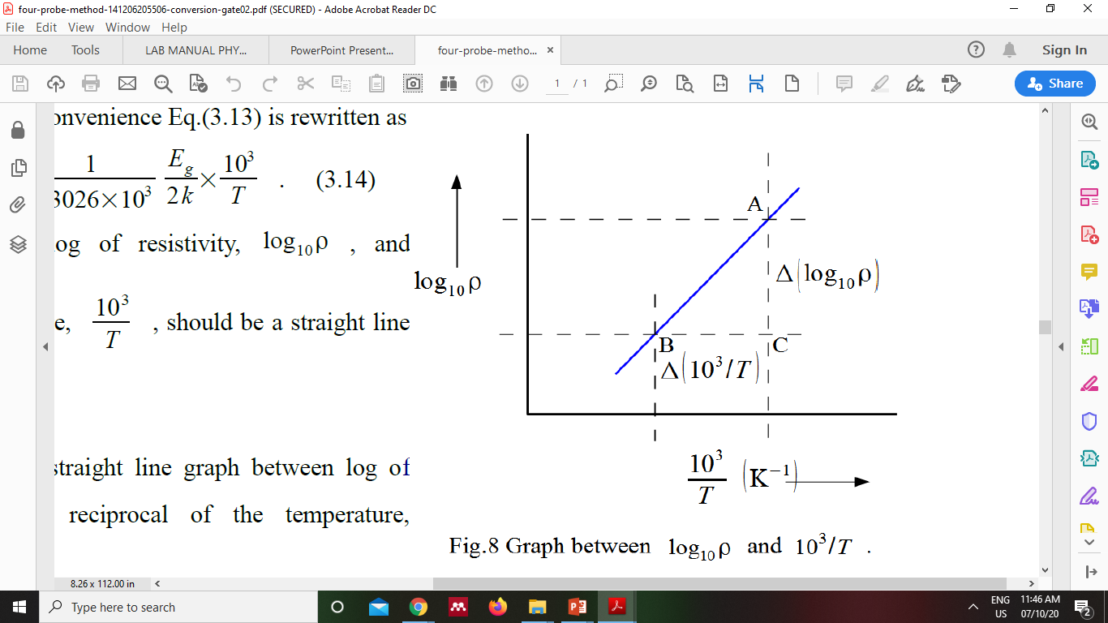
How to calculate energy Band gap from the plotted graph?
Plot the graph between 1000/T (along x-axis ) and log₁₀ρ (along y-axis). Find the slope and then use thee following formula

Slide 34

Activity based question
A
A1.1. In this four probe experiment, a Germanium crystal is kept inside the oven. What is the voltage drop at 25 °C when current 1µA is passing through outer two probes on the sample
(A) 29.08 V
(B) 29.08 mV
(C) The outer two probes are not for passing current
(D) Can not be determined with this set up

Slide 35
Activity based question
A
A1.2 : In order to run the oven and take readings from the voltmeter display panel which of the following is the correct order -
(A) Set temperature > Set the range of the voltmeter> wait > Measure
(B) Set temperature > Set the range of the voltmeter > Run > wait > Run (again)
(C) Set the range of the voltmeter > Run > wait> Set temperature
(D) No need to it manually, data will be automatically collected
Check the order before giving in class or modify question

Slide 36
Activity based question
A
A1.3 : The maximum range of the voltmeter that can be set up in this virtual lab set up is
(A) 1 mV
(B) 100 mV
(C) 10 V
(D) 100 V

Slide 37
Activity based question
A
A1.4 : In this experiment, lets consider the case when 3 mA of current is passing through the Ge crystal at 25 °C. The resistivity of the sample (as shown by the simulator) is –
(A) 87.24 ohm cm
(B) 87.24 ohm⁻¹ cm⁻¹
(C) 6.2011 ohm cm
(D) 6.2011 ohm⁻¹ cm⁻¹
Check the answer before giving in class or modify question

Slide 38
Activity based question
A
A1.5 : In the Four probe experiment, when the temperature of the Ge crystal is increased from 55 °C to 65 °C the change in resistivity (for I = 3 mA) is
(A) 0.2512 ohm cm
(B) 5.2749 ohm cm
(C) 5.0204 ohm cm
(D) None of the above
Check the answer before giving in class or modify question

Slide 39
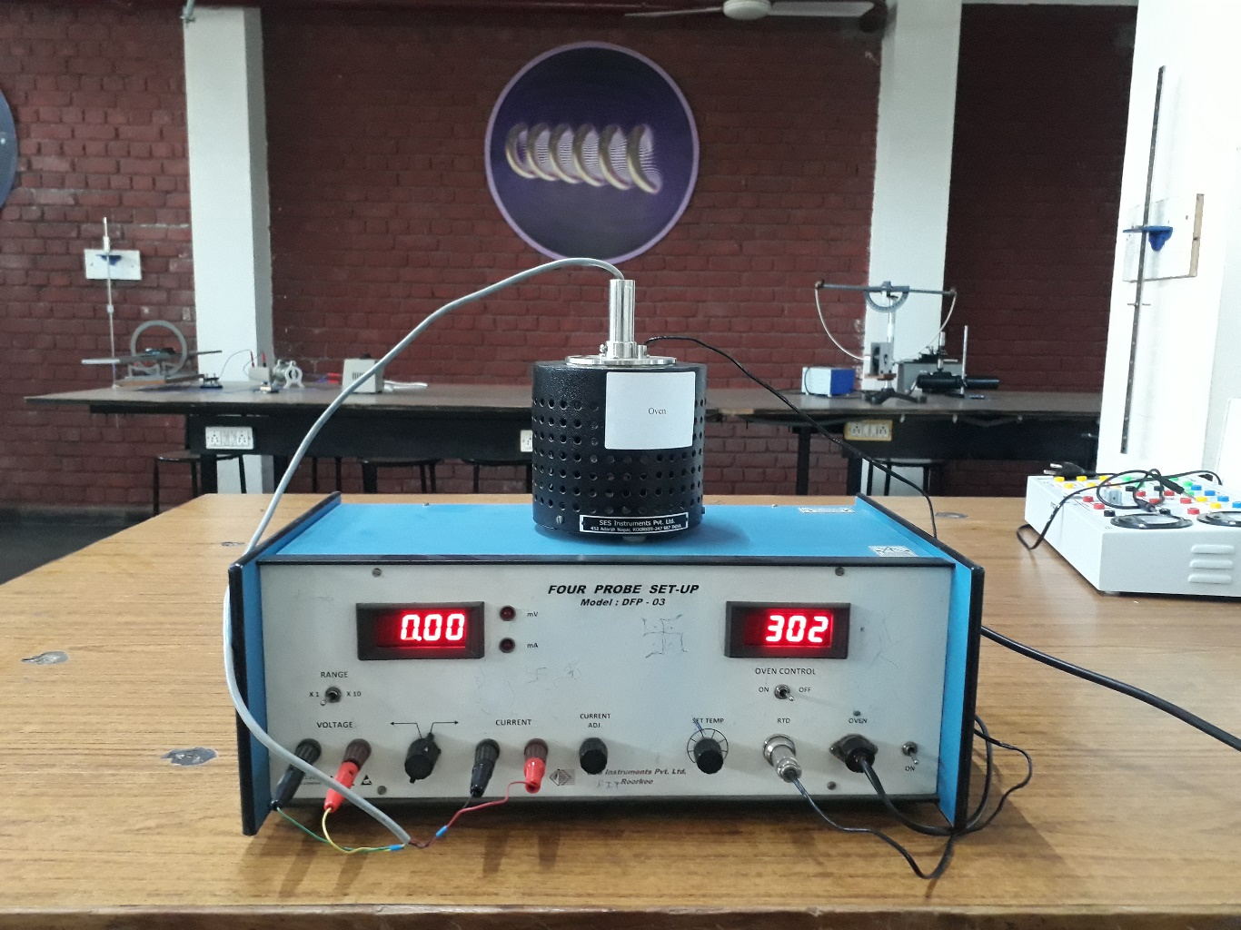
Experimental set up in our lab
Apparatus: Probe arrangement, Four probes set up with digital millivoltmeter and constant current generator, Sample crystal ( Germanium), Oven
oven
milliammeter/millivoltmeter display
Temperature display panel
Ge crystal
Four probes
Connection to
temperature sensor
Voltage leads
Current leads
Dr. Subhojyoti Sinha

